Slide 1
Access Landsat-Based Evapotranspiration
15 November, 2022
Notes:
National Aeronautics and Space Administration

Slide 2
Objectives
By the end of this exercise, you will be able to subset and download evapotranspiration (ET) data over the Sao Francisco Verdadeiro (SFV) watershed using a Goggle Google Earth portal and import to QGIS
Requirements
QGIS installed on your computer
https://arset.gsfc.nasa.gov/sites/default/files/water/drought/Introduction%20to%20QGIS.pdf
A shapefile for the Sao Francisco Verdadeiro watershed saved on your computer
http://arset.gsfc.nasa.gov/

Slide 3
Outline
Part 1: Select Landsat Images and Calculate METRIC ET
Part 2: QGIS analysis of the ET data for January & February 2016 and 2017

Slide 4
Part 1: Select Landsat Images and Calculate METRIC ET

Slide 5

Select Landsat Images and Calculate METRIC ET
Go to http://eeflux-level1.appspot.com/
On the EEFlux page you will see the following options:
Instruction: provides information about the ET data and directions on how to use the EEFlux website
FAQ: provides frequently asked questions
Date Information: allows for date range selection
Location Information: allows spatial selection by moving the orange marker on the world map. In the window the latitude and longitude values appear in decimal degrees as you move the marker.
Search for Images: starts the search for images for the selected date range and spatial location

Slide 6
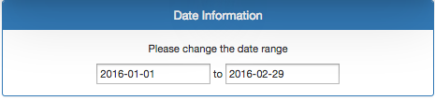
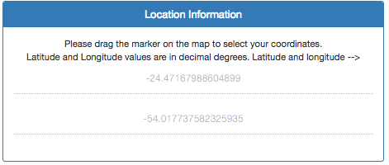
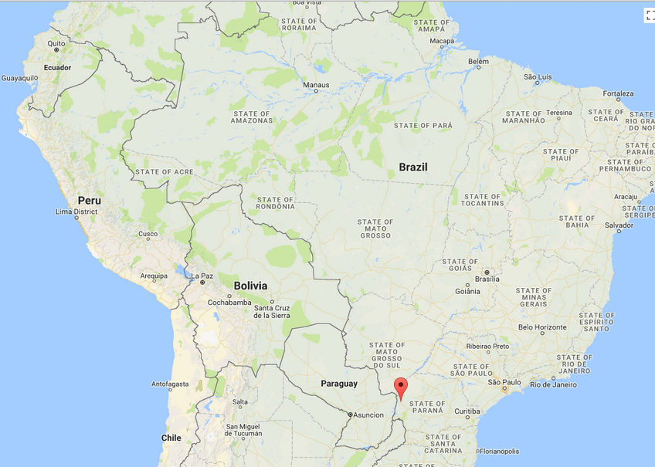
Select Landsat Images and Calculate METRIC ET
Enter the following options:
Date Information: Using the calendar, select 1 to 29 February 2016.
Location: Drag the marker on the map to the latitude and longitude close to -24.47° and -54.01°
Click on Search for Images. You will get a list of images with dates and percent cloud cover of the image

Slide 7
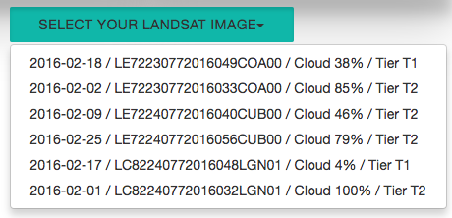
Select Landsat Images and Calculate METRIC ET
In filenames LE7 is Landsat ETM+ (Landsat 7) and LC8 is OLI/TIRS combined from Landsat 8
In the image on the right: LC82240772016032LGN01
224 and 077 are path and row of the image
2016 is the year
032 is the Julian Day
the last five digits are for the ground station ID

Slide 8
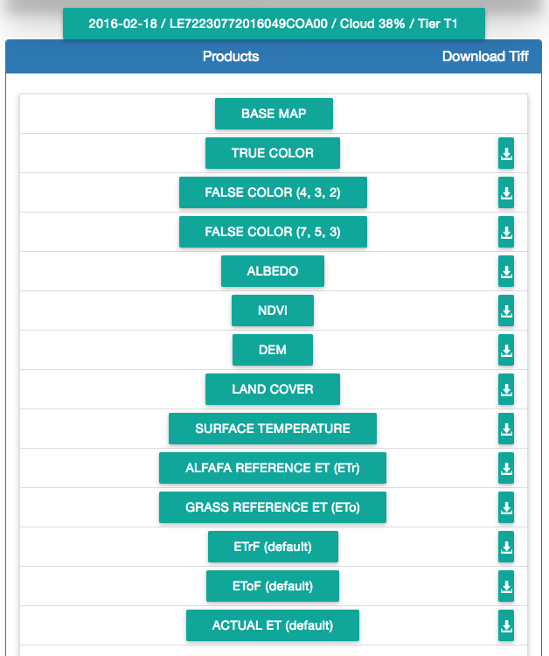
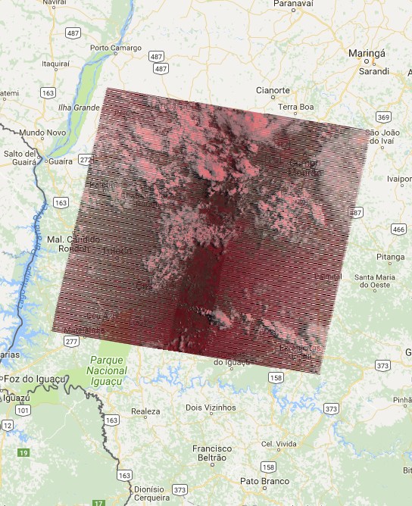
Select Landsat Images and Calculate METRIC ET
Click on the first image and you will see the Landsat image displayed on the map, along with a list of parameters derived from the image
Note the list of parameters available for this image:
The reference ET for Alfalfa (ET_{r}) and grass (ET_{o}) surfaces are available
ET_{r}F is the ratio of actual ET (ET_{c}) to ET_{r}
ET_{o}F is the ratio of ET_{c} and ET_{o}

Slide 9
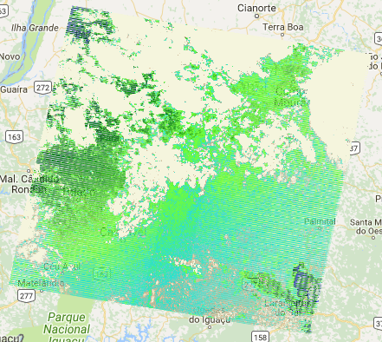
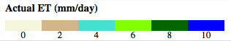
Select Landsat Images and Calculate METRIC ET
Examine each image in the list one by one and write down the cloud cover for each
Note: the browser back arrow may not work. Click on the date and image window to go to the next image
Select the images one by one and click on Actual ET (Default)
You will get the ET map on the right
Look at the color bar on the left below the parameter list. Zoom in on the ET map to examine it closely.

Slide 10
Select Landsat Images and Calculate METRIC ET
Download and save ET as a GeoTIFF file by clicking on the down arrow next to the Actual ET. You will get the files in .zip format. Unzip the files to get the ET data in GeoTIFF format.
Repeat the above steps for 1 to 28 February 2017 and save a GeoTIFF file for each day.

Slide 11
Questions
Visually compare the ET maps for Landsat 7 images to that from Landsat 8 and comment on the difference you see in the quality of the data.
What is the unit of ET?
Compare the ET for images with different cloud cover. What happens when an image has large (>50%) cloud cover?

Slide 12
Part 2: QGIS Analysis of ET Data for February 2016 & 2017

Slide 13

QGIS Analysis of ET Data for February 2016 & 2017
Open QGIS and start a new project
From the top menu bar, click on Web, select Open Layer Plugin and select a background map
Click on the menu on the left bar and click Add Vector to add the SFW shapefile: sfv_4326.shp

Slide 14
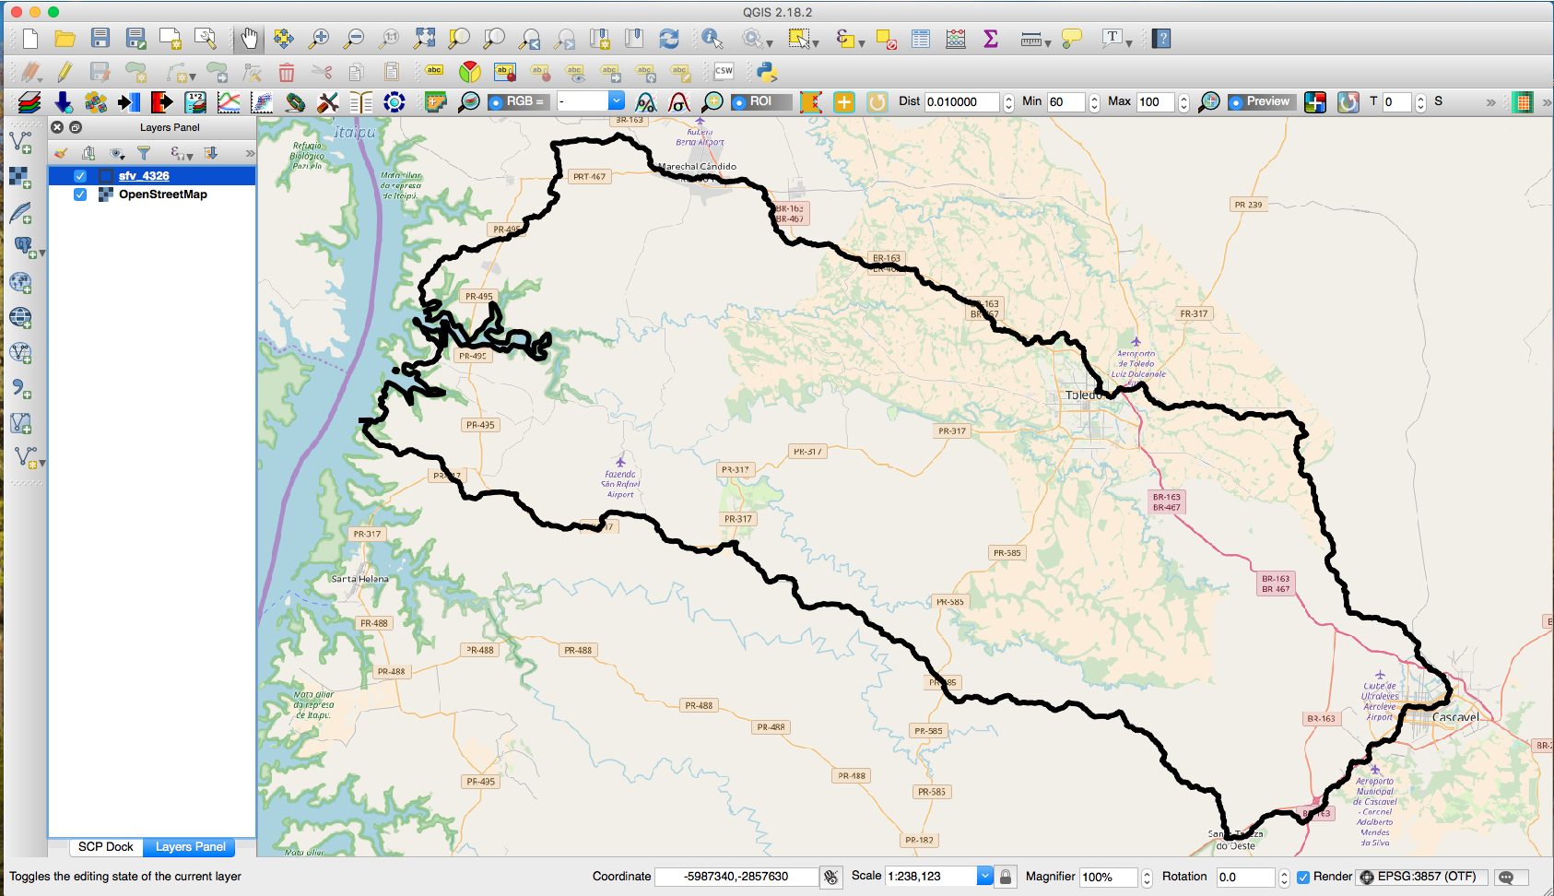
QGIS Analysis of ET Data for February 2016 & 2017
Make the shapefile layer transparent with only the boundary outlined on the map
Right click on the layer file and go to Properties > Style
Click on the down arrow in the Fill window and select Transparent fill
Click on the down arrow in the Outline window and choose a color of the shapefile boundary (The example uses black)
Choose outline width to be 2.0
Click Apply and OK to get the result in the QGIS window

Slide 15

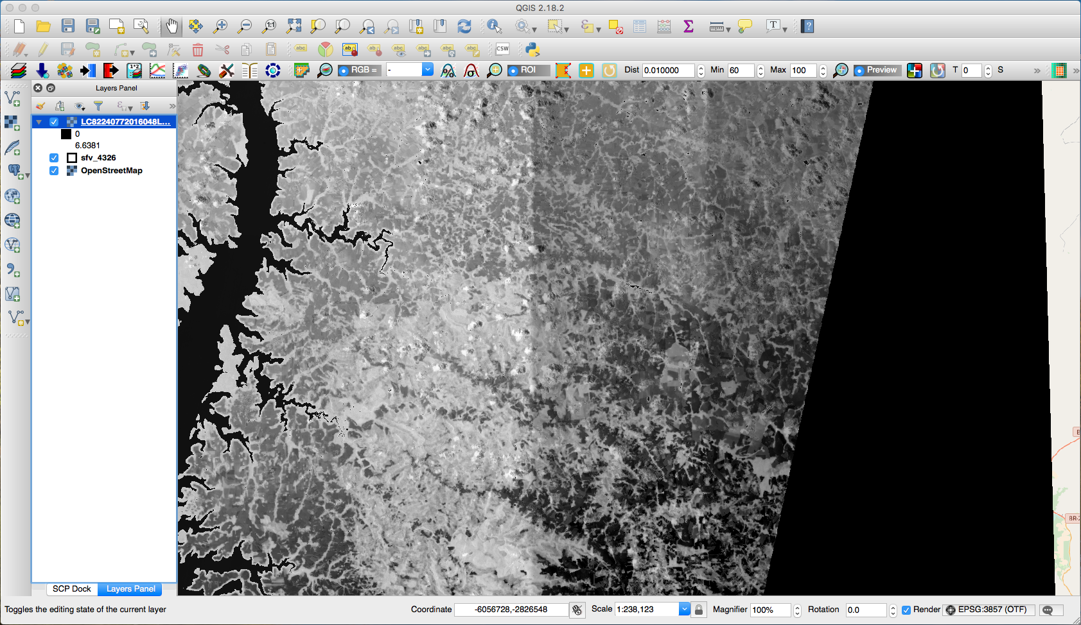
QGIS Analysis of ET Data for February 2016 & 2017
Next click on the Add Raster function on the left
Navigate to your saved ET files and click on Open to add the Landsat 8 data file: LC82240772016048LGN01_ETa.ETr.tif for February 17, 2016 and LC82240772017050LGN00_ETa.ETr.tif for February 19, 2017
You will see the GeoTIFF images appear in grayscale

Slide 16
QGIS Analysis of ET Data for February 2016 & 2017
Now clip the interpolated ET layers to the SFW shapefile
On the top bar go to Raster > Extraction > Clipper to open the Clipper options window
In the Input File (raster) window select: LC82240772016048LGN01_ETa.ETr.tif.
In the Output file window, select the output folder and enter the file name (Suggestion: ET17Feb2016_Clipped)
Check the Mask Layer and in the Mask Layer window select the shapefile named sfv_4326
Click OK on at the bottom right
You should see the data clipped by the shapefile boundary

Slide 17
QGIS Analysis of ET Data for February 2016 & 2017
Repeat Step 6 for LC82240772017050LGN00_ETa.ETr.tif
Suggestion: save the clipped file as ET19Feb2017_Clipped
You can also remove the original ‘unclipped’ ET layers form the QGIS if you choose

Slide 18
QGIS Analysis of ET Data for February 2016 & 2017
Right click on the clipped raster layers one at a time and follow the steps to get colored ET maps:
Go to Properties > Style
Select the Render Type as Singleband Pseudocolor
Next to Color, make sure the color palette is Brown-Green by selecting (BrBG)
Select Min value to be 0 mm/day and Max value to be 6 mm/day
Below the color display, change the Mode to Equal Interval and Classes to 7. Click Classify, then click Apply
Click OK to close the Change Color box

Slide 19
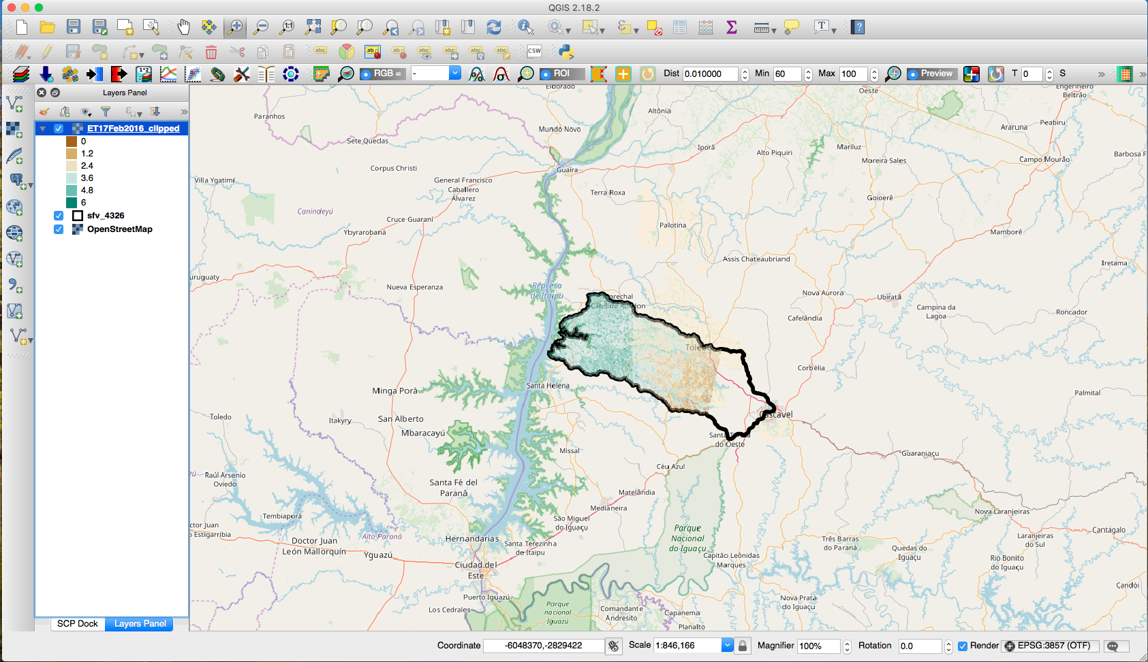
QGIS Analysis of ET Data for February 2016 & 2017
Make the clipped ET layers transparent to see the map underneath
Right click on the layer file and go to Properties > Transparency
Set the Transparency level to 50%
Under No data value set Additional no data value to 0
Click Apply and then OK

Slide 20
Questions
Which days show larger ET?
Which image has more cloud cover? Do you think the cloud cover has impact on the ET data?
Which factors decide what the ET values for any location or time will be?
What are the challenges with using Landsat ET for water budget analysis?

